Slide 1
AWS

Slide 2
What is AWS
Amazon Web Services, is a subsidiary of Amazon that provides on-demand cloud computing platforms and APIs to individuals, companies, and governments, on a metered pay-as-you-go basis.
It was founded on 3rd March 2006.

Slide 3
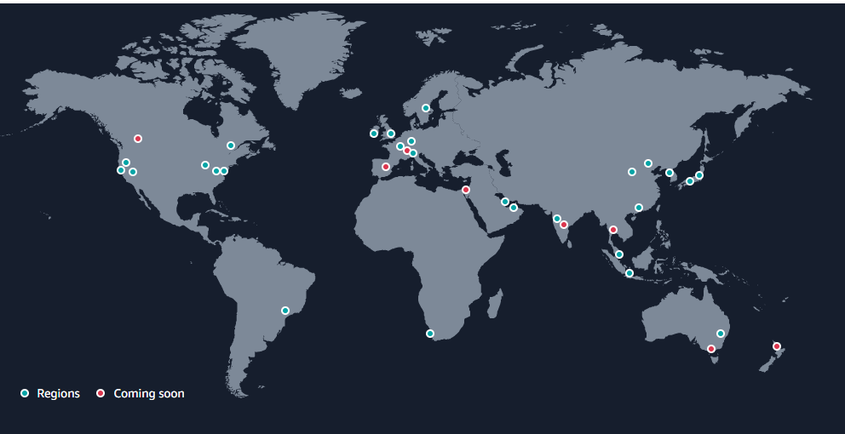
Region
Region is a separate geographic area.
Each region is completely independent and isolated from other region.
The AWS Cloud spans in 27 geographic regions around the world.
Regions in Australia, Canada, India, Israel, New Zealand, Spain, Switzerland, and Thailand.

Slide 4
Region
When you view your resources, you see only the resources that are tied to the Region that you specified.
This is because Regions are isolated from each other, and we don't automatically replicate resources across Regions.
There is a charge for data transfer between Regions.
An AWS account provides multiple Regions so that you can launch Amazon service instances in locations that meet your requirements.
Code | Name | Code | Name
us-east-2 | US East (Ohio) | ap-northeast-3 | Asia Pacific (Osaka)
us-east-1 | US East (N. Virginia) | ap-northeast-2 | Asia Pacific (Seoul)
us-west-1 | US West (N. California) | ap-southeast-1 | Asia Pacific (Singapore)
us-west-2 | US West (Oregon) | ap-southeast-2 | Asia Pacific (Sydney)
af-south-1 | Africa (Cape Town) | ap-northeast-1 | Asia Pacific (Tokyo)
ap-east-1 | Asia Pacific (Hong Kong) | ca-central-1 | Canada (Central)
ap-southeast-3 | Asia Pacific (Jakarta) | eu-central-1 | Europe (Frankfurt)
ap-south-1 | Asia Pacific (Mumbai) | eu-west-1 | Europe (Ireland)
me-south-1 | Middle East (Bahrain) | eu-west-2 | Europe (London)
me-central-1 | Middle East (UAE) | eu-south-1 | Europe (Milan)
sa-east-1 | South America (São Paulo) | eu-west-3 | Europe (Paris)
 |  | eu-north-1 | Europe (Stockholm)

Slide 5
How to choose right Region
Consider four main aspects when deciding which AWS Region to host your applications and workloads:
Latency: If your application is sensitive to latency, choose a Region that is close to your user base. This helps prevent long wait times for your customers.
Price: Due to the local economy and the physical nature of operating data centers, prices may vary from one Region to another. The pricing in a Region can be impacted by internet connectivity, prices of imported pieces of equipment, customs, real estate, and more. Instead of charging a flat rate worldwide, AWS charges based on the financial factors specific to the location.
Service availability: Some services may not be available in some Regions. The AWS documentation provides a table containing the Regions and the available services within each one. So, choose the region according to your service requirements.
Compliance: Enterprise companies often need to comply with regulations that require customer data to be stored in a specific geographic territory. If applicable, you should choose a Region that meets your compliance requirements.

Slide 6
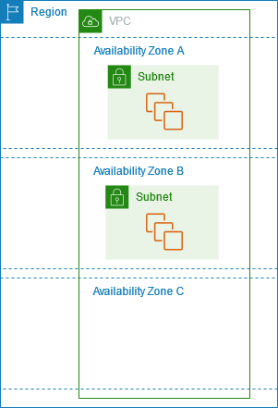
Availability Zone (AZ)
Availability Zones are multiple, isolated locations within each Region.
An AZ consists of one or more data centers with redundant power, networking, and connectivity.
The AWS Cloud spans 87 Availability Zones within 27 geographic regions around the world, with announced plans for 24 more Availability Zones and 8 more AWS regions.
The code for Availability Zone is its Region code followed by a letter identifier. For example, us-east-1a.

Slide 7
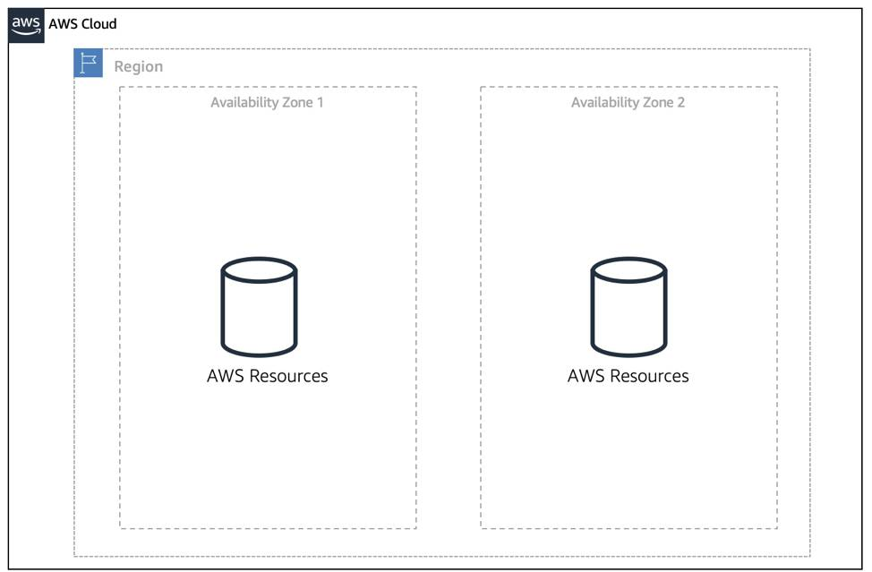
Availability Zone (AZ)
When you launch an instance, you can optionally specify an Availability Zone in the Region that you are using.
If you do not specify an Availability Zone, an Availability Zone for your instance is automatically specified.
To keep your application available, you need to maintain high availability and resiliency.
A well-known best practice for cloud architecture is to replicate across multiple AZs.
At a minimum, you should use two AZs. If one entire AZ fails, your application will have infrastructure up and running in at least a second AZ to take over the traffic.

Slide 8
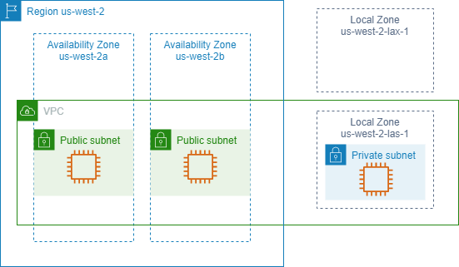
Local Zone (LZ)
LZ provide you the ability to place resources (computing, storage etc.) in multiple locations close to your end users.
A Local Zone is an extension of an AWS Region in geographic proximity to your users.
Local Zones have their own connections to the internet and support AWS Direct Connect, so that resources created in a Local Zone can serve local users with low-latency communications.
To use a Local Zone, you must first enable it.
The code for a Local Zone is its Region code followed by an identifier that indicates its physical location. E.g., us-west-2-lax-1 in Los Angeles.

Slide 9
Interacting with AWS
There are three different ways to use AWS services:
AWS Management Console: One way to manage cloud resources is through the web-based console, where you log in and click on the desired service. This can be the easiest way to create and manage resources when you first begin working with the cloud.
AWS Command Line Interface (CLI): The AWS CLI is a unified tool to manage AWS services. With just one tool to download and configure, you control multiple AWS services from the command line and automate them with scripts. The AWS CLI is open-source, and there are installers available for Windows, Linux, and Mac OS.
AWS Software Development Kits (SDKs): AWS Software Development Kits (SDKs) are open-source and maintained by AWS for the most popular programming languages, such as C++, Go, Java, JavaScript, .NET, Node.js, PHP, Python, and Ruby. Developers commonly use AWS SDKs to integrate their application source code with AWS services.

